Slide 1
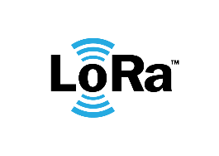
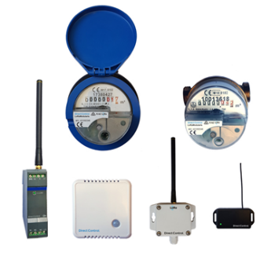




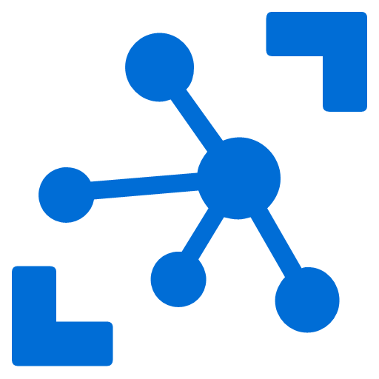


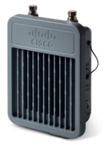
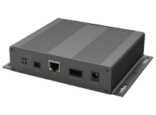
Azure Cloud
Cloud Processing AI, ML, Visualization
Azure IoT Hub
LoRaWAN Network Server
Decoder Modules
Custom Routing
Local Datastore
Decoder 1
Built-in Decoders
Decoder 2
Decoder n
Local Processing
LoRa Basics™ Station Concentrators
Azure IoT Edge
Notes:
Possible replacement for the current image on the front of the docs. Integration with Azure
Possibility for local processing
LBS integration

Slide 2
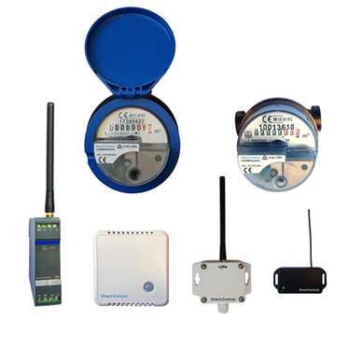
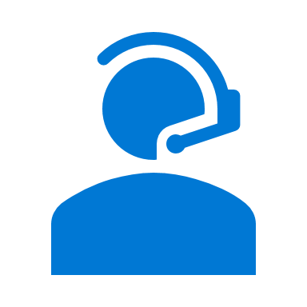

Local Infrastructure
Local datastore
Local Queue
Local Processing, forwarding, ML and AI, Visualization
Decoder Modules
Decoder 1
Dedicated Azure Function
Decoder 2
LoRaWAN Gateways
Decoder n
LoRa Network Server
Device Management
Built-in decoders
LoRa Basics™ Station Concentrators
Azure IoT Edge
Azure IoT Hub
Azure Cloud
On-premise
Telemetry flow
Management flow
Notes:
Generalized from Michelin use case

Slide 3
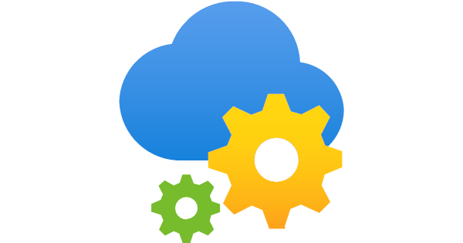

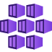
Additional cloud processing services (ML/AI, Visualization)
Azure App Configuration
Azure Cache for Redis
Decoder containers
Decoder 1
Decoder 2
Decoder n
Azure Function
LoRaWAN Gateways
LoRa Network Server
Built-in decoders
Azure Kubernetes Service
Azure IoT Hub
Device Management
LoRa Basics™ Station Concentrators
Azure Cloud
On-premise
Telemetry flow
Management flow
Notes:
Generalized from Michelin use case

Slide 4
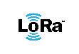

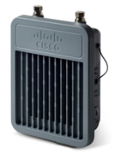
LoRa Network Server
Azure IoT Edge
Azure Cloud
LoRa Basics™ Station
Concentrator
Concentrators
edge Gateway
Notes:
Generalized with multiple iotedge – not sure if this is relevant
Resiliency for basics station downtime -> highlight that and deduplication , at least once garantee

Slide 5
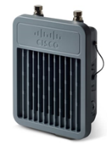
LoRa Network Server
Concentrator Deduplication
Azure IoT Edge
Azure Cloud
LoRa Basics™ Station
Concentrators
Redundant Concentrators
Edge Gateways
Notes:
Generalized with multiple iotedge – not sure if this is relevant
Resiliency for basics station downtime -> highlight that and deduplication , at least once garantee

Slide 6
LoRa Network Server
Concentrator Deduplication
Azure IoT Edge
Gateway Deduplication
LoRa Network Server
Azure Cloud
Concentrator Deduplication
Azure IoT Edge
LoRa Basics™ Station
Concentrators
Redundant Concentrators
Redundant Edge Gateways
Notes:
Generalized with multiple iotedge – not sure if this is relevant
Resiliency for basics station downtime -> highlight that and deduplication , at least once garantee

Slide 7
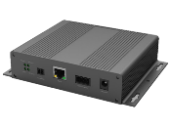
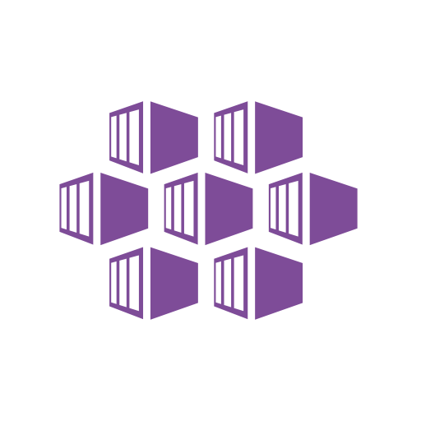
LoRa Basics™ Station Concentrators
LoRa Network Server
Built-in decoders
AKS
Azure IoT Hub
Local infra
Azure Cloud
Notes:
Deployment: deployment on windows if this is a requirement.
Deployment: edge in the cloud on EFLOW. Multiple LBS to LNS in the cloud (tcp)

Slide 8

LoRa Network Server
LoRa Basics™ Station Concentrators
EFLOW
Windows Server
Azure Cloud
Azure IoT Hub
Local infra
Notes:
Deployment: deployment on windows if this is a requirement.
Deployment: edge in the cloud on EFLOW. Multiple LBS to LNS in the cloud (tcp)

Slide 9






Azure Cloud
Application Insights
Log Analytics
FileBeat
MetricBeat
Metrics Collector
Logs & Metrics
Logs
Metrics
Metrics
LoRa Network Server
IoTEdge Agent
IoTEdge Hub
LoRa Network Server
IoTEdge Agent
IoTEdge Hub
Built-in decoders
Built-in decoders
Azure IoT Edge
Azure IoT Edge
Notes:
ELK integration
Azure monitor as well, metrics and logs to appinsights, workbooks,

Slide 10




